Slide 1
Lab. 04
Logic Design Lab.
Spring 2018
Prof. Chang-Gun Lee
(cglee@snu.ac.kr)
TA. WonJae Jang
TA. Wonseok Lee
TA. Alena Kazakova
TA. Dongwan Kang
(ta@rubis.snu.ac.kr)

Slide 2
Contents
Multiplexer, Demultiplexer
Encoder, Decoder
Verilog
Lab
Implement a Decoder using Verilog
Implement a 3-to-8 Decoder using a 2-to-4 Decoder
Homework (due 10th, April)

Slide 3
Multiplexer, Demultiplexer

Slide 4
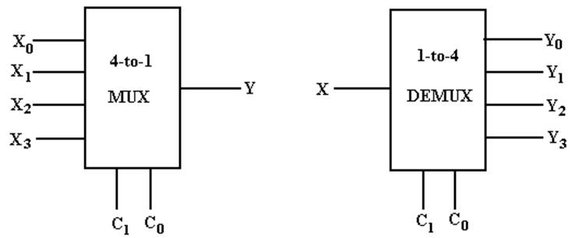
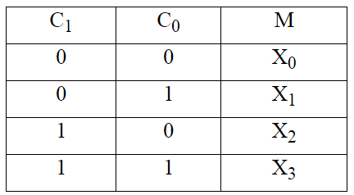
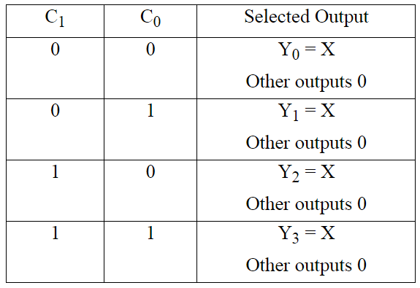
Multiplexer and Demultiplexer
2^{n} inputs, 1 outputs
Selection lines exist
1 inputs, 2^{n} outputs
Selection lines exist
Notes:
모르는지 물어보고 요청하면 그려줄 것.

Slide 5
Encoder, Decoder

Slide 6
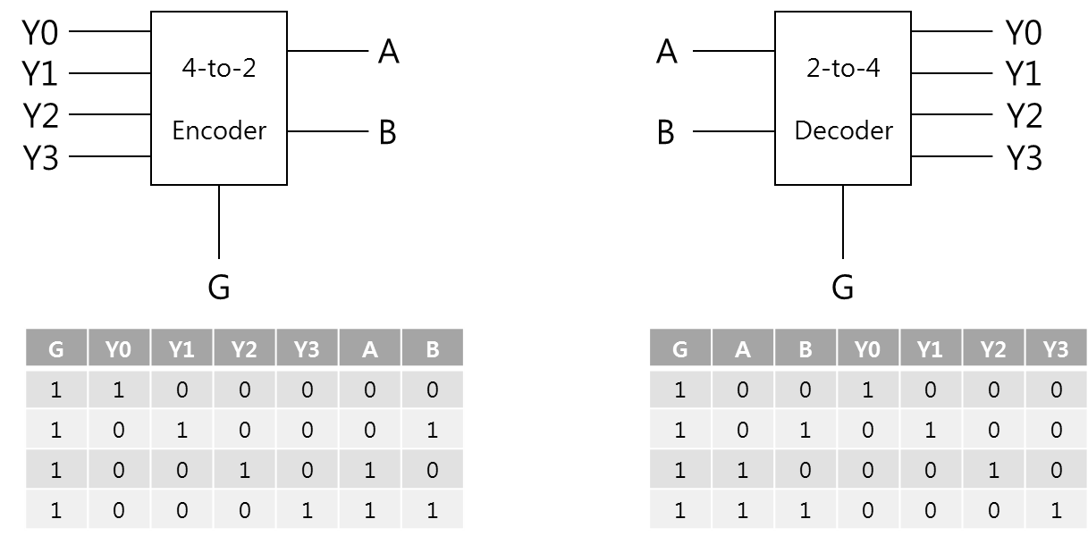
Encoder, Decoder
2^{n} inputs, n outputs
Outputs the binary value of the selected input
No selection lines exist
n inputs, 2^{n} outputs
Selects one of 2^{n} outputs by decoding the binary value on the n inputs
No selection lines exist

Slide 7
Verilog

Slide 8
Overview
Hardware description languages (HDLs)
We will focus on Verilog
Verilog Basics
Verilog Notations
Verilog Operators
Verilog Keywords & Constructs
Types of programming (description)
Structural description
Data-flow style description
Behavioral description

Slide 9
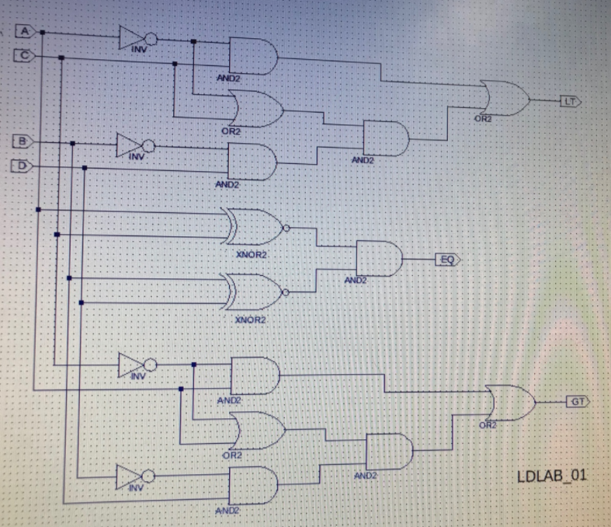
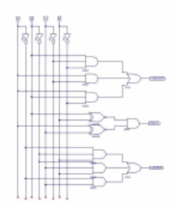
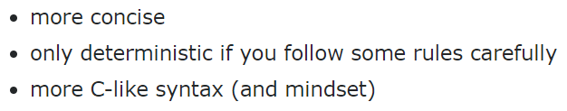

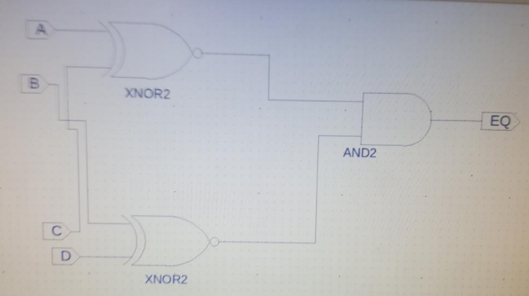
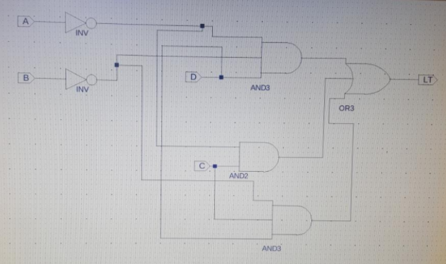
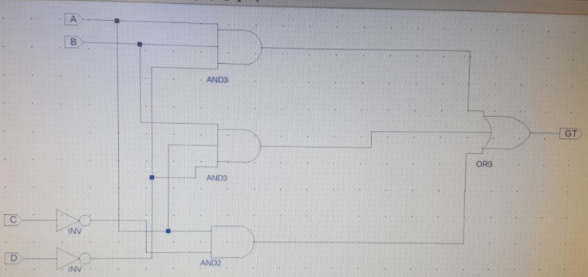
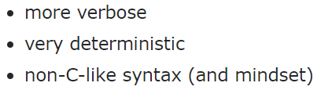


Hardware description languages (HDLs)
Verilog
FOCUS
VHDL
2018 Spring LDLAB HW
Hard to understand
Too many papers…
➔ Let’s make standard HDL !
Superset extension
SystemVerilog

Slide 10
Verilog Basics : Verilog Notations (1)
Verilog is:
Case sensitive
Based on the programming language C
Comments:
// this is a comment Single line
/* this is a comment */ Multiple line
Statement terminator:
Every statement should be terminated with ; (semi-colon)

Slide 11
Verilog Basics : Verilog Notations (2)
Literals
[bit_size]’[base_format][value]
Example > below literals represent same value
8’b10100001
8’hA1
8’d161
Identifiers
Scalar (always 1 bit)
Example > below identifiers are similar with single variable in C
A, B, myA, myB…
Vector (bit size is specified as [high_bit:low_bit])
Example > below identifiers are similar with array variable in C
arrA[7:0], arrB[15:0], arrMyA[7:0], arrMyB[15:0]…

Slide 12
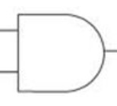
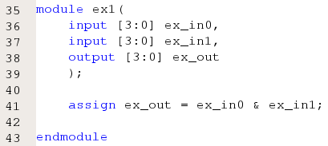

Verilog Basics : Verilog Operators (1)
Bitwise Operators
~ NOT
& AND
| OR
^ XOR
Example >
ex1
ex_in0[0]
ex_out[0]
ex_in1[0]
ex_in0[1]
ex_out[1]
ex_in1[1]
ex_in0[2]
ex_out[2]
ex_in1[2]
ex_in0[3]
ex_out[3]
ex_in1[3]
Notes:
Paradigm shift 설명. RHS 변화할 때 마다 바뀜.
Wire의 Textural form일 뿐.

Slide 13
Verilog Basics : Verilog Operators (2)
Logical & Relational Operators
&&, | |, = =, !=, >=, <=, >, <, etc.
Arithmetic Operators
+, -, etc.
Concatenation Operators
{identifier_1, identifier_2, …}
Examples >
{ex_in0[1:0],ex_in1[3:2]}

Slide 14
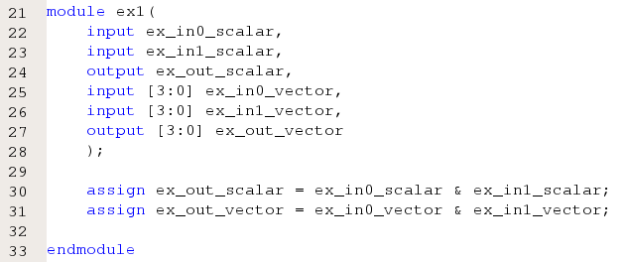
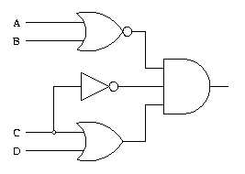
Verilog Basics : Verilog Keywords & Constructs (1)
Module declaration
Start with module, end with endmodule
Module IO port declaration
Inputs use keyword, input, Outputs use keyword output.
Example >
ex1
Notes:
Paradigm Shift RECAP 순서와 상관 없음.
위자드가 있음.

Slide 15
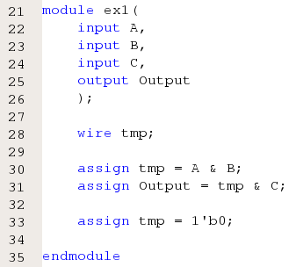
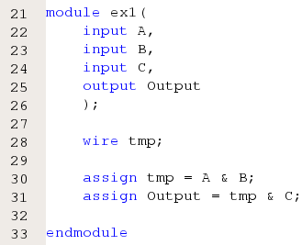
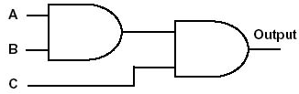
Verilog Basics : Verilog Keywords & Constructs (2)
Wire Declaration
Scalar Example : wire t1, t2;
Vector Example : wire[7:0] t1, t2;
Example >
Error
tmp
Notes:
중간에 Temporal wire를 사용하는 경우.
항상 이미지를 가지고 코딩.

Slide 16
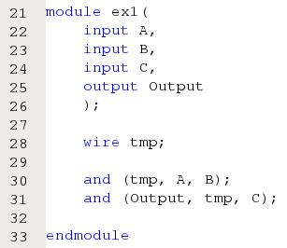
Verilog Basics : Verilog Keywords & Constructs (3)
Primitive Gates
buf, not, and, or, nand, nor, xor, xnor
Syntax:
[gate_operator] [instance_identifier] [(output, input_1, input_2, …)]
Example >

Slide 17
Verilog Basics : Verilog Keywords & Constructs (4)
Process
The body of a process consists of procedural statement to make desired outputs from inputs as like a common programming
initial – executes only once beginning at t = 0.
Syntax: initial Statement;
Example > initial begin Statement; Statement; … end
always – executes at t = 0 and repeatedly thereafter following repeat conditions.
Syntax: always Repeat condition Statement;
Example > always Repeat condition begin Statement; Statement; … end
Notes:
빠르게 설명, 예제로 보여줄 것임.

Slide 18
Verilog Basics : Verilog Keywords & Constructs (5)
Timing Control Statement (for repeat conditions)
The body of the process consists of procedural assignments
Blocking assignments
Example: C = A + B;
Execute sequentially as in a programming language
Non-blocking assignments
Example: C <= A + B;
Evaluate right-hand sides, but do not make any assignment until all right-hand sides evaluated. Execute concurrently unless delays are specified.
Type | Syntax | Description
Delay Control | #10 | Delay 10 unit time
Event Control | @(a) | Wait until signal ‘a’ is changed
 | @(posedge a) @(negedge a) | Wait until signal ‘a’ is changed to ‘1’ Wait until signal ‘a’ is changed to ‘0’
Level Control | wait (a==0) | Wait until signal ‘a’ is equal to ‘0’
Notes:
빠르게 설명, 예제로 보여줄 것임.

Slide 19
Verilog Basics : Verilog Keywords & Constructs (6)
Examples > blocking vs. Non-blocking
Always @(*)
begin
B = A;
C = B;
end
Suppose initially A = 0, B = 1, and C = 2. After execution, B = 0 and C = 0.
Always @(*)
begin
B <= A;
C <= B;
end
Suppose initially A = 0, B = 1, and C = 2. After execution, B = 0 and C = 1.
Notes:
빠르게 설명, 예제로 보여줄 것임.

Slide 20
Verilog Basics : Verilog Keywords & Constructs (7)
Because of the use of procedural rather than continuous assignment statements, assigned values must be retained over time.
Register type: reg
The reg in contrast to wire stores values between executions of the process
A reg type does not imply hardware storage!
Notes:
빠르게 설명, 예제로 보여줄 것임.

Slide 21
Verilog Basics : Verilog Keywords & Constructs (8)
Conditional constructs
The if-else
If (condition)
begin procedural statements end
{else if (condition)
begin procedural statements end}
else
begin procedural statements end
The case
case expression
{case expression : statements}
endcase;
Notes:
빠르게 설명, 예제로 보여줄 것임.

Slide 22
Types of programming (description)
Describe hardware at varying levels of abstraction
Structural description
Textual replacement for schematic
Data-flow style description
Textual replacement of truth table
Behavioral/functional description
Define just WHEN, WHAT, not HOW

Slide 23
Tutorials

Slide 24
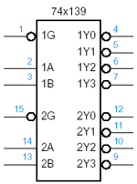
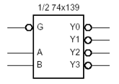
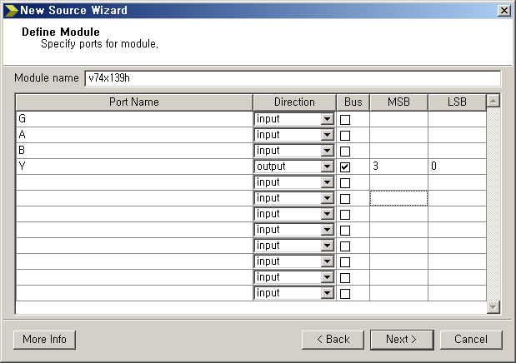
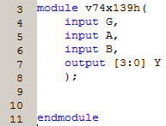
1. Design Structure
=
+
Notes:
모든 방법론의 공통 사항.
버블 설명.
아까 말한 위자드.
하프를 3가지 방법으로 해볼 것임.

Slide 25
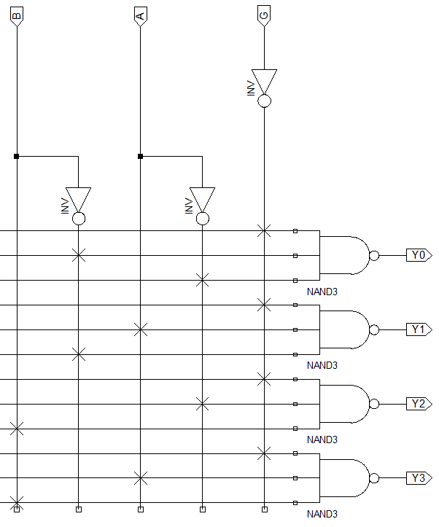
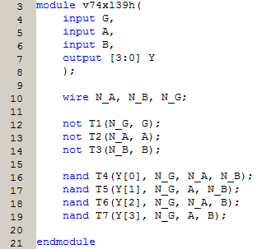
2-1. Structural Description
Textual representation of schematic
N_B
N_A
N_G
Notes:
그냥 스키마틱을 텍스트로 표현한 형태의 디자인.

Slide 26
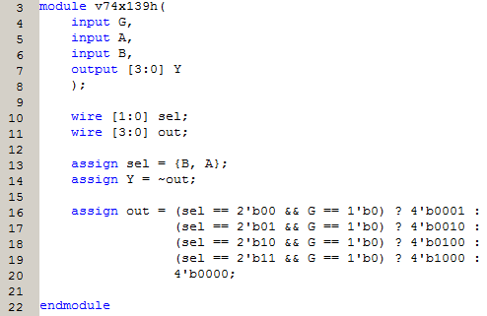
2-2. Data Flow Description
B | A | G | Y[3:0]
0 | 0 | 0 | 1110
0 | 1 | 0 | 1101
1 | 0 | 0 | 1011
1 | 1 | 0 | 0111
0 | 0 | 1 | 1111
0 | 1 | 1 | 1111
1 | 0 | 1 | 1111
1 | 1 | 1 | 1111
Textual representation of truth table
Notes:
그냥 진리표를 옮긴 형태의 디자인.
삼항 연산자, sensitive list in wire.

Slide 27
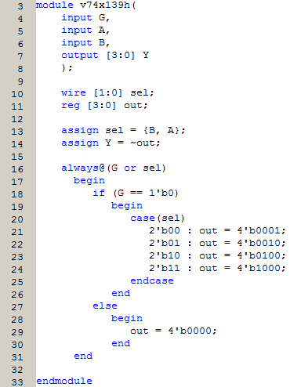
2-3. Behavioral Description
If there is no else-block,
reg out will be synthesized as storage
When?
Which action?

Slide 28
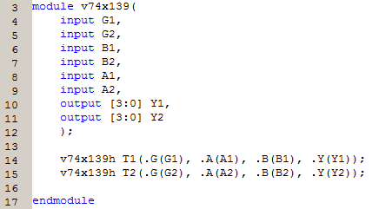
2-4. Unify Modules
It is same as using gate primitives

Slide 29
Lab

Slide 30
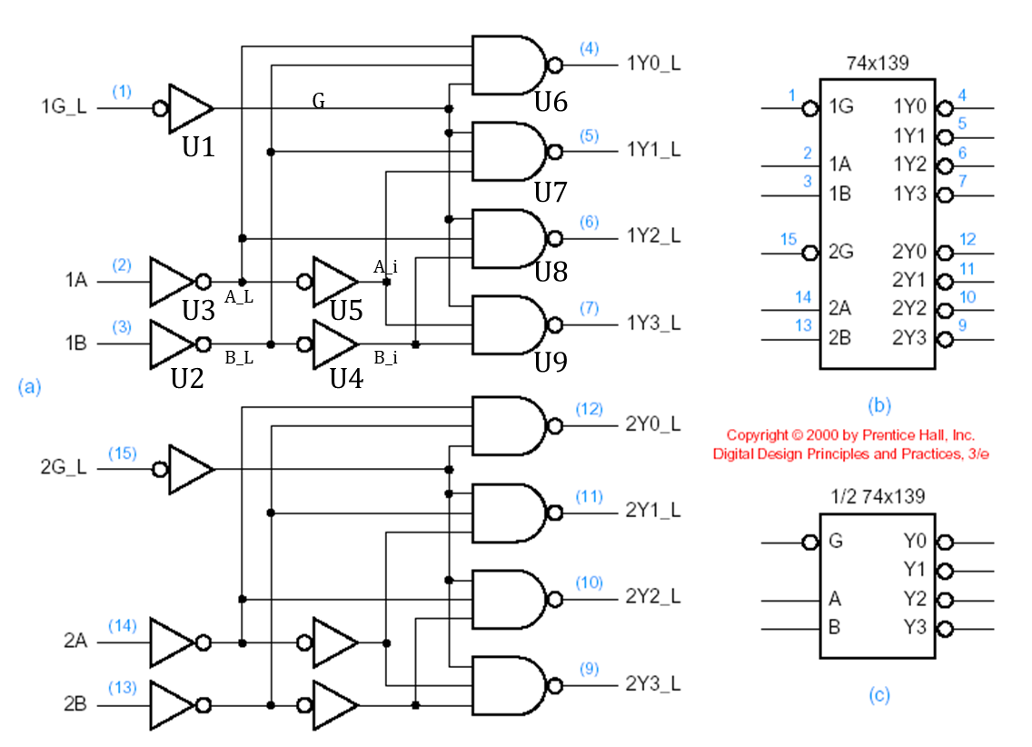
Today
1. Design a 74x139 using Verilog.
Practice all the designing methods for half 74x139 each and simulate them
Implement a 74x139 and simulate it
2. Design a 3-to-8 decoder using 2-to-4 decoders only and simulate it.

Slide 31
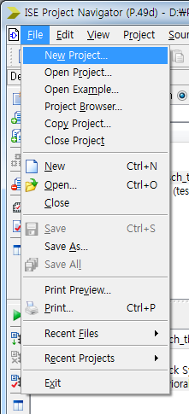
Create a new Verilog project

Slide 32
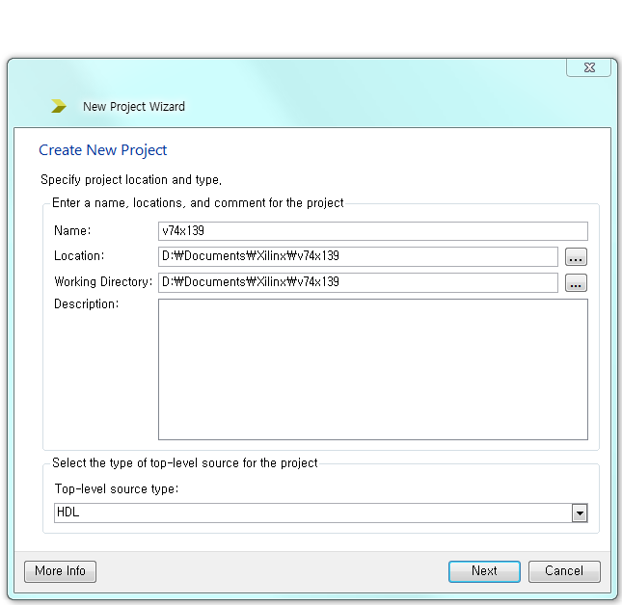
Set the project name, location, type

Slide 33
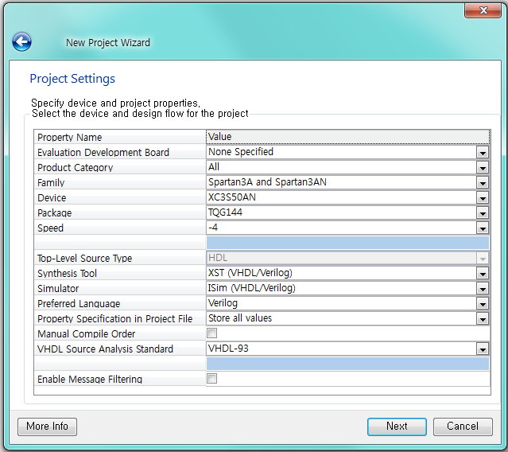
Set the project name, location, type

Slide 34
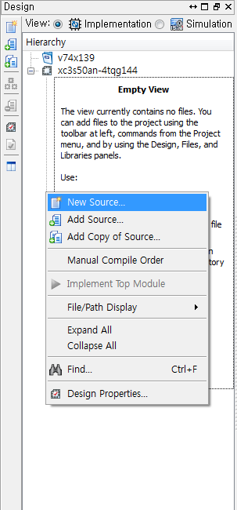
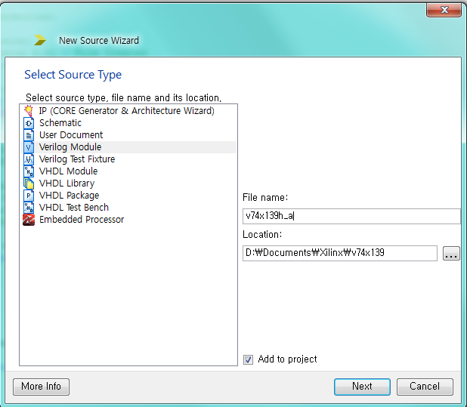
Create a new Verilog source

Slide 35
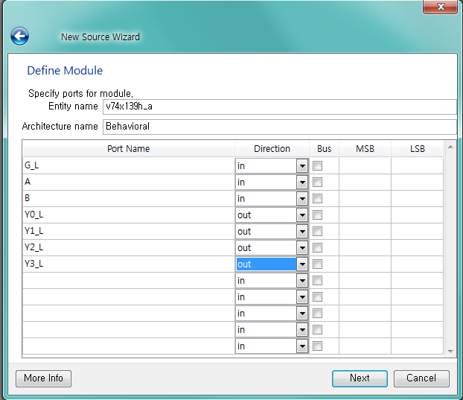
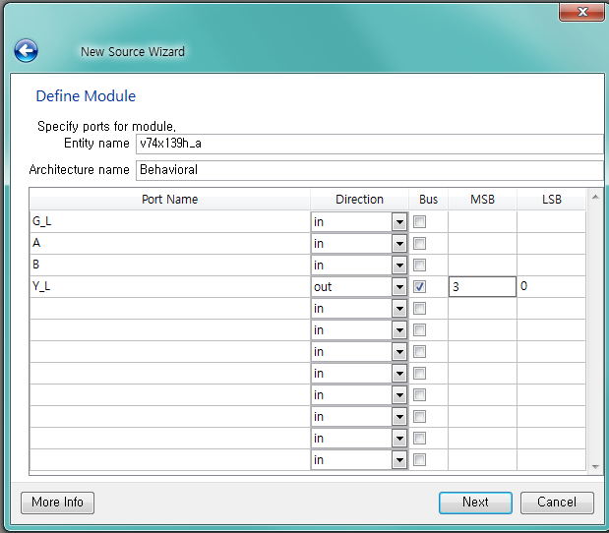
Create a new Verilog source
or

Slide 36
Write your own Verilog codes

Slide 37
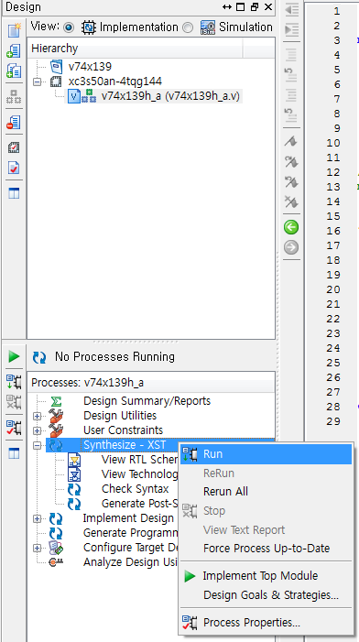
Compile and check errors

Slide 38
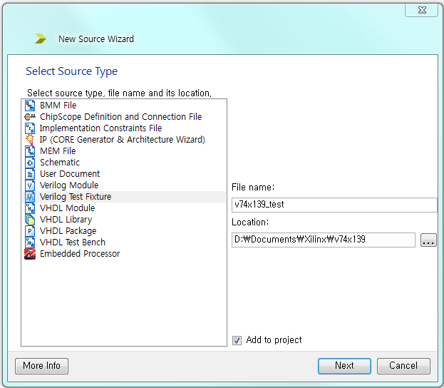
Create a Verilog test bench

Slide 39
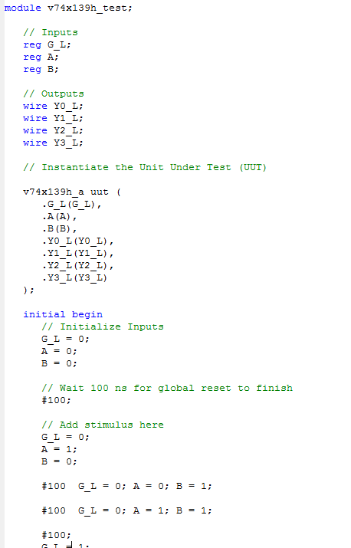
Write a Verilog test bench codes

Slide 40
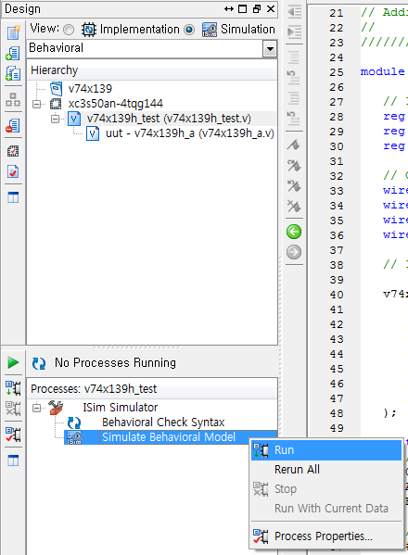
Simulate it

Slide 41
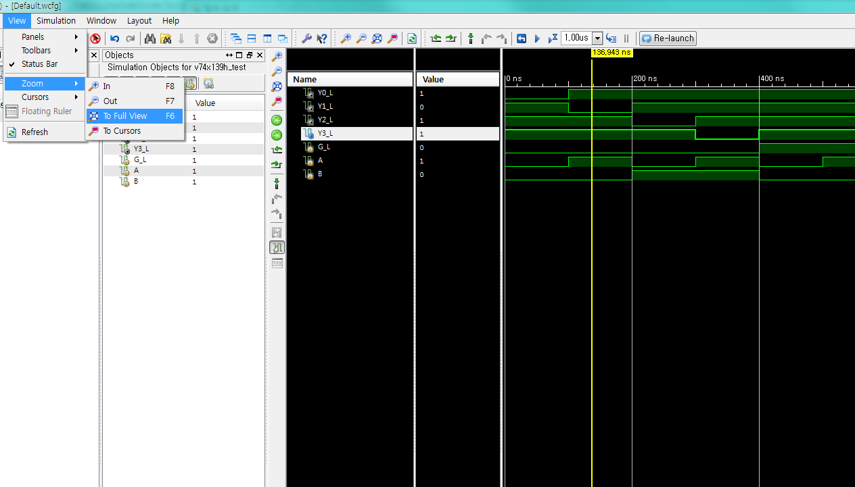
Simulation result

Slide 42
Homework

Slide 43
Homework
Implement 4-to-1 MUX with all the designing methods that we practiced and Simulate it.
(2) Discuss about each type of descriptions.
(Pros & Cons, etc.)

Slide 44
Report
Write a report
# of pages doesn’t matter
Documents should be submitted as PDF file.
The file size should be less than 15Mb.
Due : April, 10th (Before class begin at 7:00pm)

Slide 45
NOTICE !!!
SUBMISSION FORMAT
MAIL TITLE : LDLAB_170328_조_이름_학번
Ex > LDLAB_170328_01_홍길동_2017-12345
ATTACHED FILE NAME : LDLAB_170328_조_이름_학번.pdf
Ex > LDLAB_170328_01_홍길동_2017-12345.pdf
Attach
your simulation screen captures,
source codes of your implementation,
source codes of your simulation,
at a single pdf file !!!

